Slide 1
Computer vision: models, learning and inference
Chapter 19
Temporal models

Slide 2
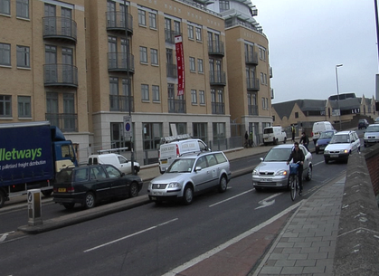
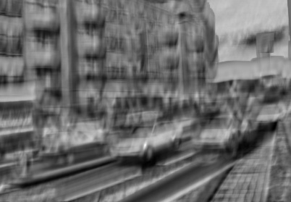

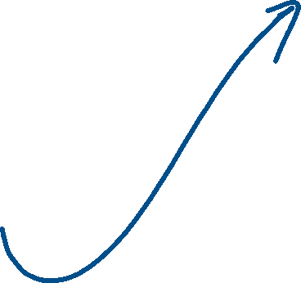



Slide 3
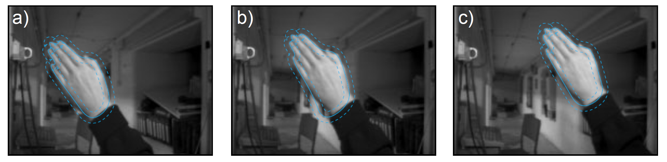
Goal
To track object state from frame to frame in a video
Difficulties:
Clutter (data association)
One image may not be enough to fully define state
Relationship between frames may be complicated

Slide 4
Structure
Temporal models
Kalman filter
Extended Kalman filter
Unscented Kalman filter
Particle filters
Applications
Computer vision: models, learning and inference. ©2011 Simon J.D. Prince
4

Slide 5



Temporal Models
Consider an evolving system
Represented by an unknown vector, w
This is termed the state
Examples:
2D Position of tracked object in image
3D Pose of tracked object in world
Joint positions of articulated model
OUR GOAL: To compute the marginal posterior distribution over w at time t.
Computer vision: models, learning and inference. ©2011 Simon J.D. Prince
5

Slide 6



Estimating State
Two contributions to estimating the state:
A set of measurements x_{t}, which provide information about the state w_{t} at time t. This is a generative model: the measurements are derived from the state using a known probability relation Pr(x_{t}|w₁…w_{T})
A time series model, which says something about the expected way that the system will evolve e.g., Pr(w_{t}|w₁...w_{t-1},w_{t+1}…w_{T})
Computer vision: models, learning and inference. ©2011 Simon J.D. Prince
6

Slide 7
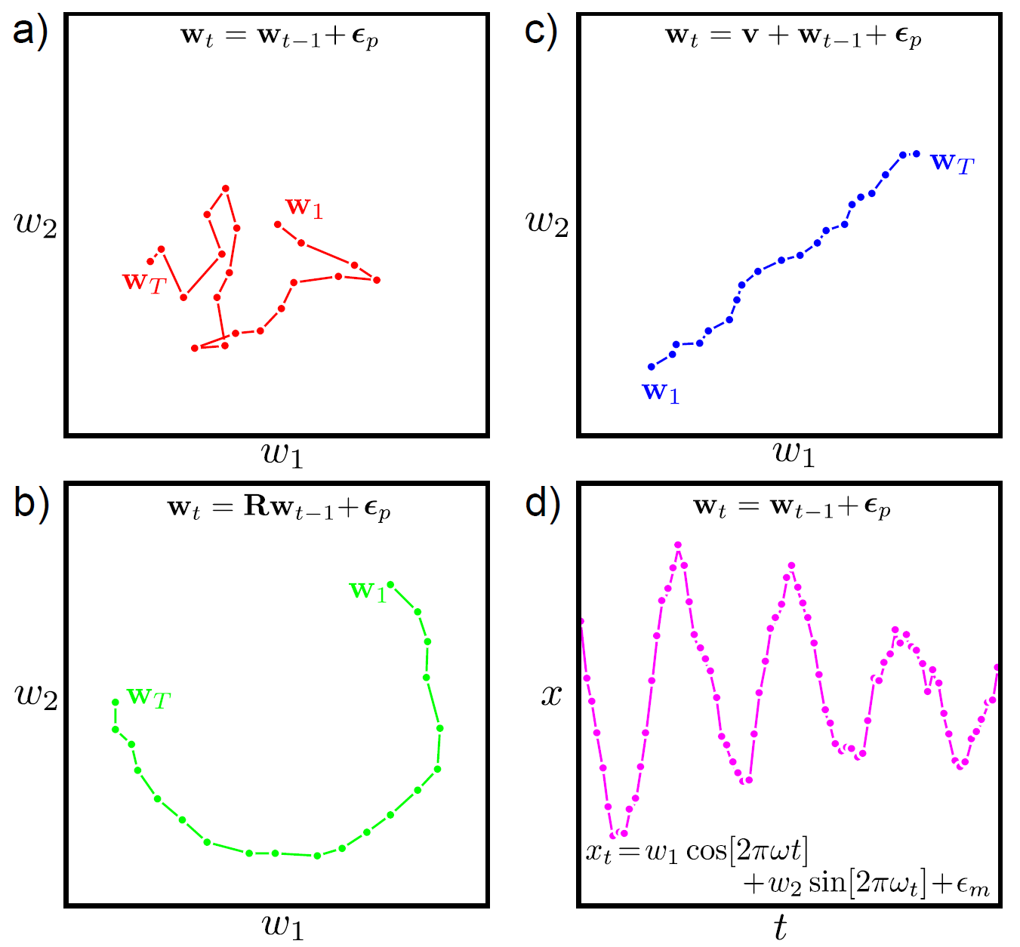


Temporal Models
Computer vision: models, learning and inference. ©2011 Simon J.D. Prince
7

Slide 8
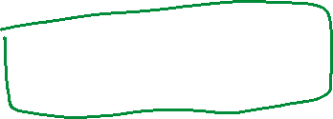

Assumptions
Only the immediate past matters (Markov)
the probability of the state at time t is conditionally independent of states at times 1...t-2 given the state at time t-1.
Measurements depend on only the current state
the likelihood of the measurements at time t is conditionally independent of all of the other measurements and the states at times 1...t-1, t+1..t given the state at time t.
Computer vision: models, learning and inference. ©2011 Simon J.D. Prince
8

Slide 9
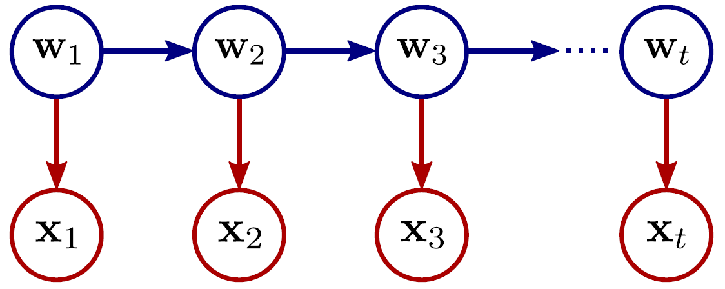















Graphical Model
World states
Measurements
Computer vision: models, learning and inference. ©2011 Simon J.D. Prince
9

Slide 10
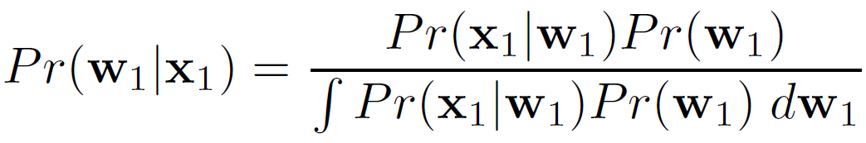
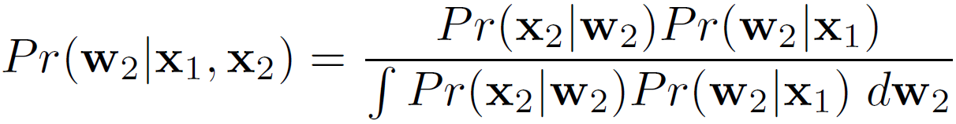
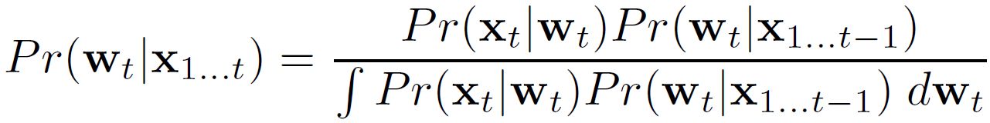







Recursive Estimation
Time 1
Time 2
from temporal model
Time t
Computer vision: models, learning and inference. ©2011 Simon J.D. Prince
10

Slide 11
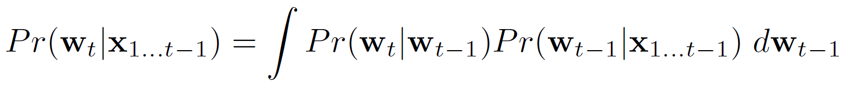
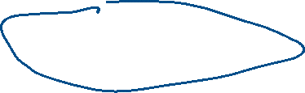
Computing the prior (time evolution)
Each time, the prior is based on the Chapman-Kolmogorov equation
Prior at time t
Temporal model
Posterior at time t-1
Computer vision: models, learning and inference. ©2011 Simon J.D. Prince
11

Slide 12


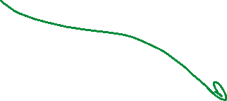
Summary
Alternate between:
Temporal Evolution
Temporal model
Measurement Update
Measurement model
Computer vision: models, learning and inference. ©2011 Simon J.D. Prince
12

Slide 13
Structure
Temporal models
Kalman filter
Extended Kalman filter
Unscented Kalman filter
Particle filters
Applications
Computer vision: models, learning and inference. ©2011 Simon J.D. Prince
13

Slide 14
Kalman Filter
The Kalman filter is just a special case of this type of recursive estimation procedure.
Temporal model and measurement model carefully chosen so that if the posterior at time t-1 was Gaussian then the
prior at time t will be Gaussian
posterior at time t will be Gaussian
The Kalman filter equations are rules for updating the means and covariances of these Gaussians
Computer vision: models, learning and inference. ©2011 Simon J.D. Prince
14

Slide 15
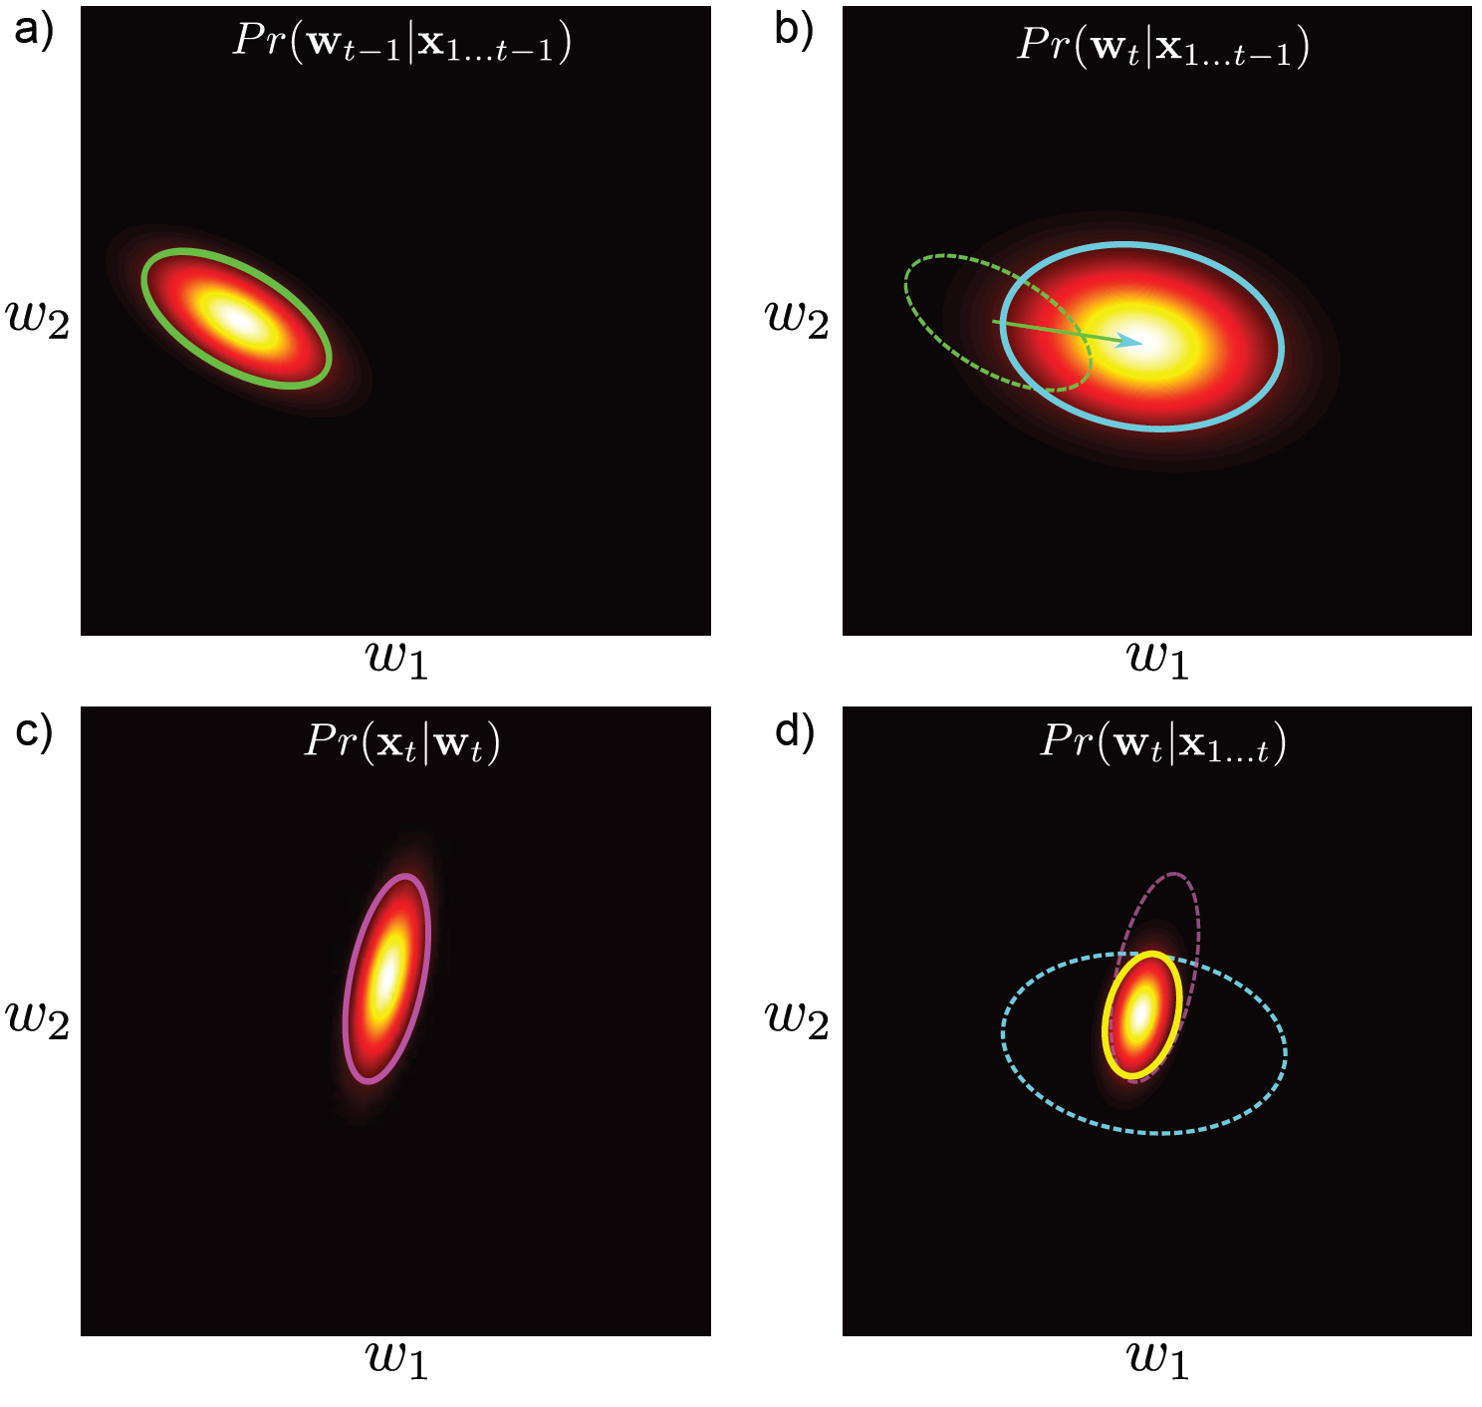
The Kalman Filter
Previous time step
Prediction
Measurement likelihood
Combination
15

Slide 16
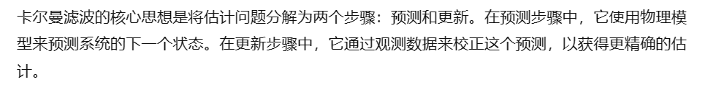
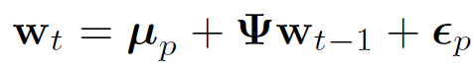
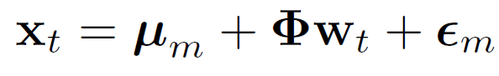
Kalman Filter Definition
Time evolution equation
State transition matrix
Additive Gaussian noise
Measurement equation
Additive Gaussian noise
Relates state and measurement
Computer vision: models, learning and inference. ©2011 Simon J.D. Prince
16

Slide 17
Kalman Filter Definition
Time evolution equation
State transition matrix
Additive Gaussian noise
Measurement equation
Additive Gaussian noise
Relates state and measurement
Computer vision: models, learning and inference. ©2011 Simon J.D. Prince
17

Slide 18
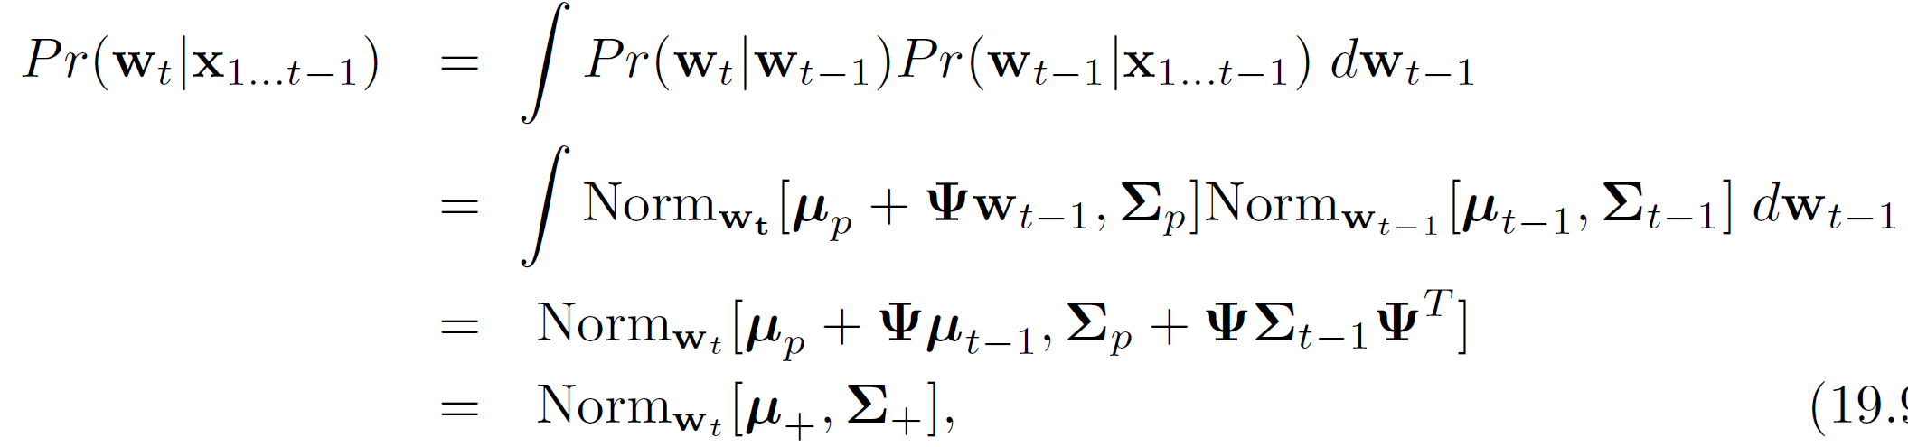


Temporal evolution (Prediction)
18

Slide 19
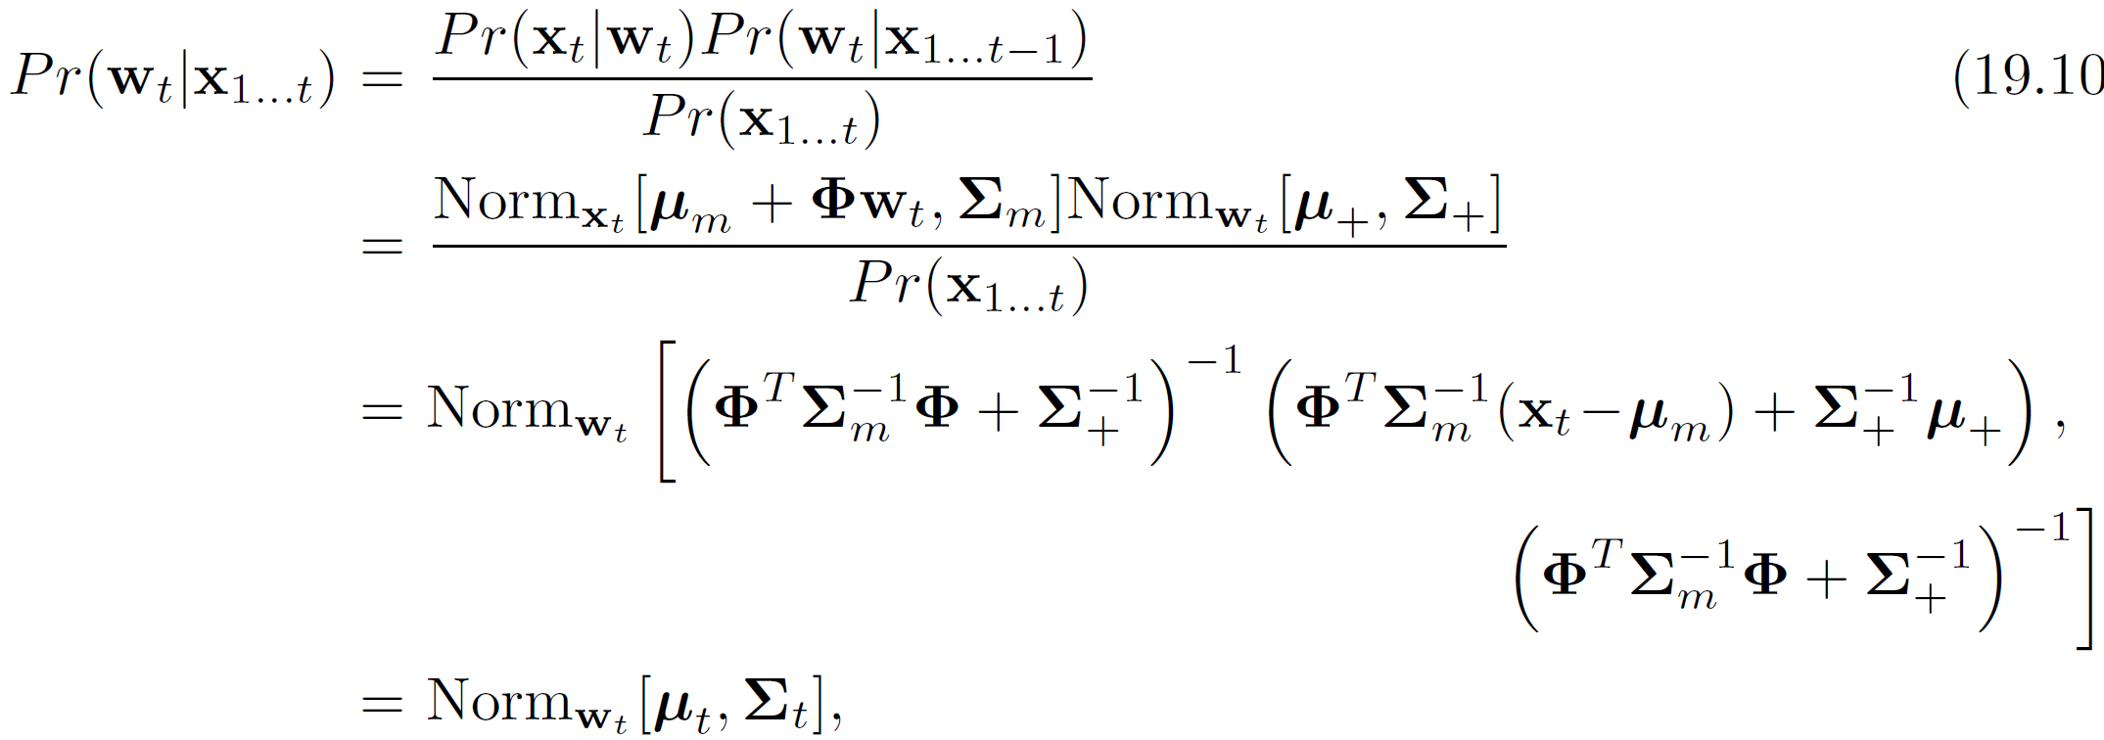






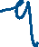

Measurement incorporation
19

Slide 20
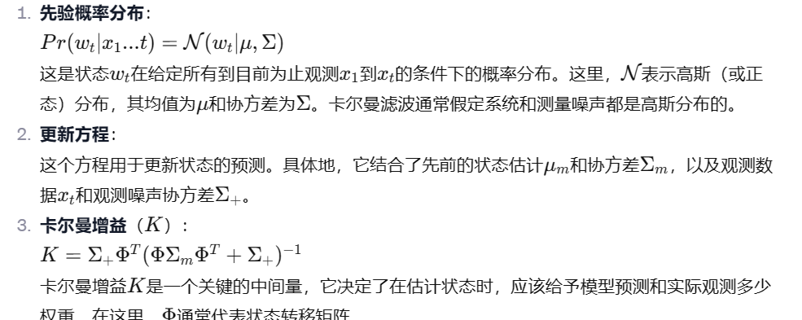
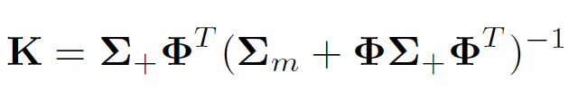

Kalman Filter
This is not the usual way these equations are presented.
Part of the reason for this is the size of the inverses: φ is usually landscape and so φ^{T}φ is inefficient
Define Kalman gain:
Computer vision: models, learning and inference. ©2011 Simon J.D. Prince
20

Slide 21
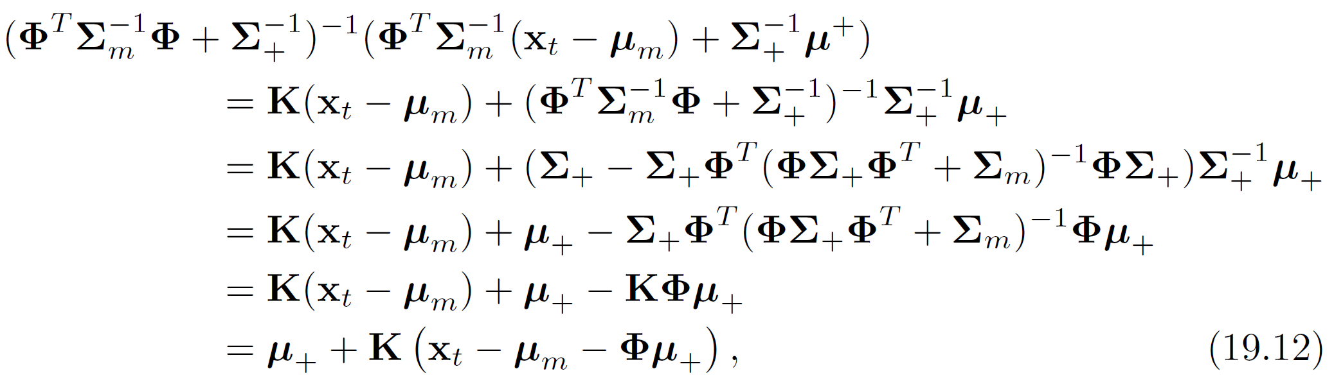
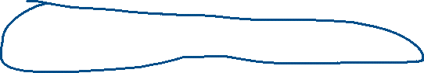


Mean Term
Using Matrix inversion relations:
Computer vision: models, learning and inference. ©2011 Simon J.D. Prince
21

Slide 22
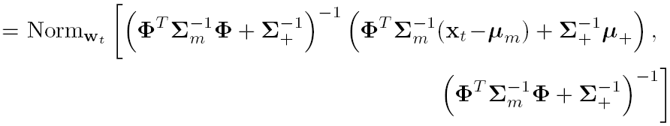
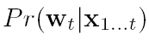
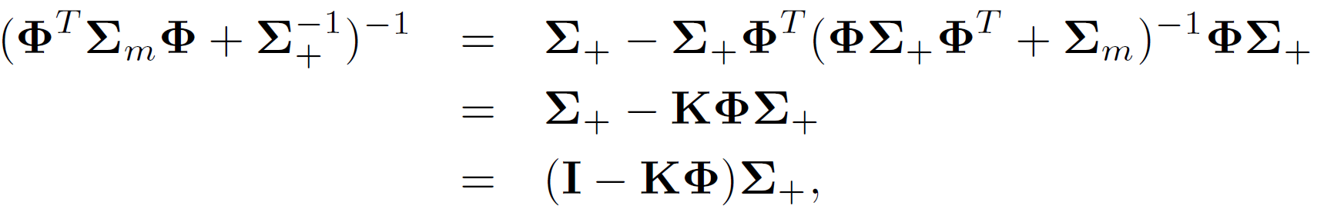




Covariance Term
Kalman Filter
Using Matrix inversion relations:
Computer vision: models, learning and inference. ©2011 Simon J.D. Prince
22

Slide 23
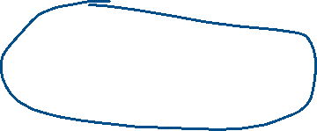
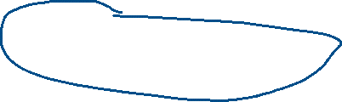
Final Kalman Filter Equation
Innovation (difference between
actual and predicted measurements
Prior variance minus a term due to information from measurement
Computer vision: models, learning and inference. ©2011 Simon J.D. Prince
23

Slide 24
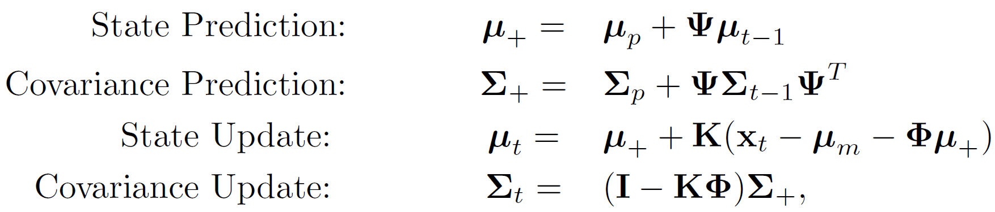
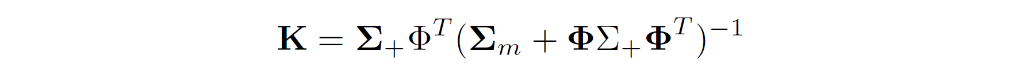
Kalman Filter Summary
Time evolution equation
Measurement equation
Inference
Computer vision: models, learning and inference. ©2011 Simon J.D. Prince
24

Slide 25
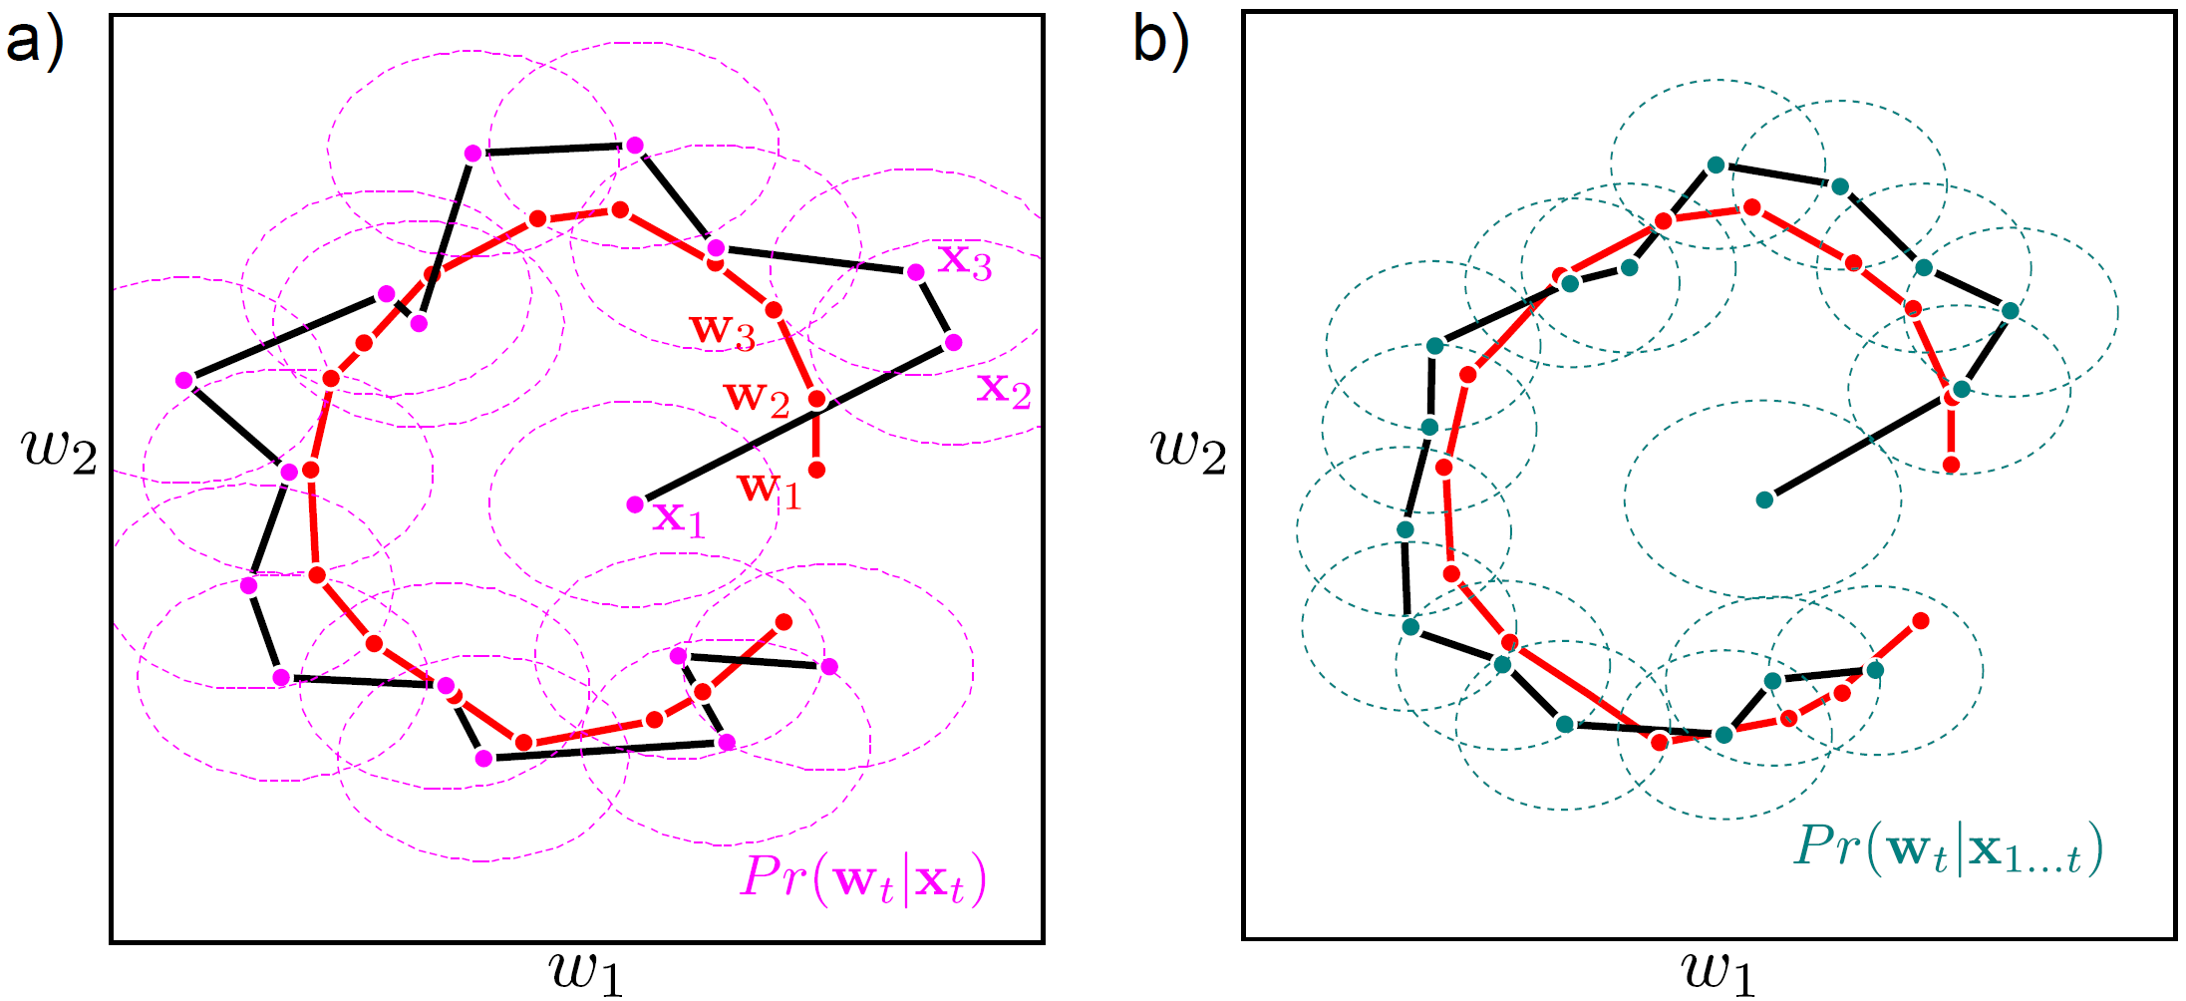
Kalman Filter Example 1
Computer vision: models, learning and inference. ©2011 Simon J.D. Prince
25

Slide 26
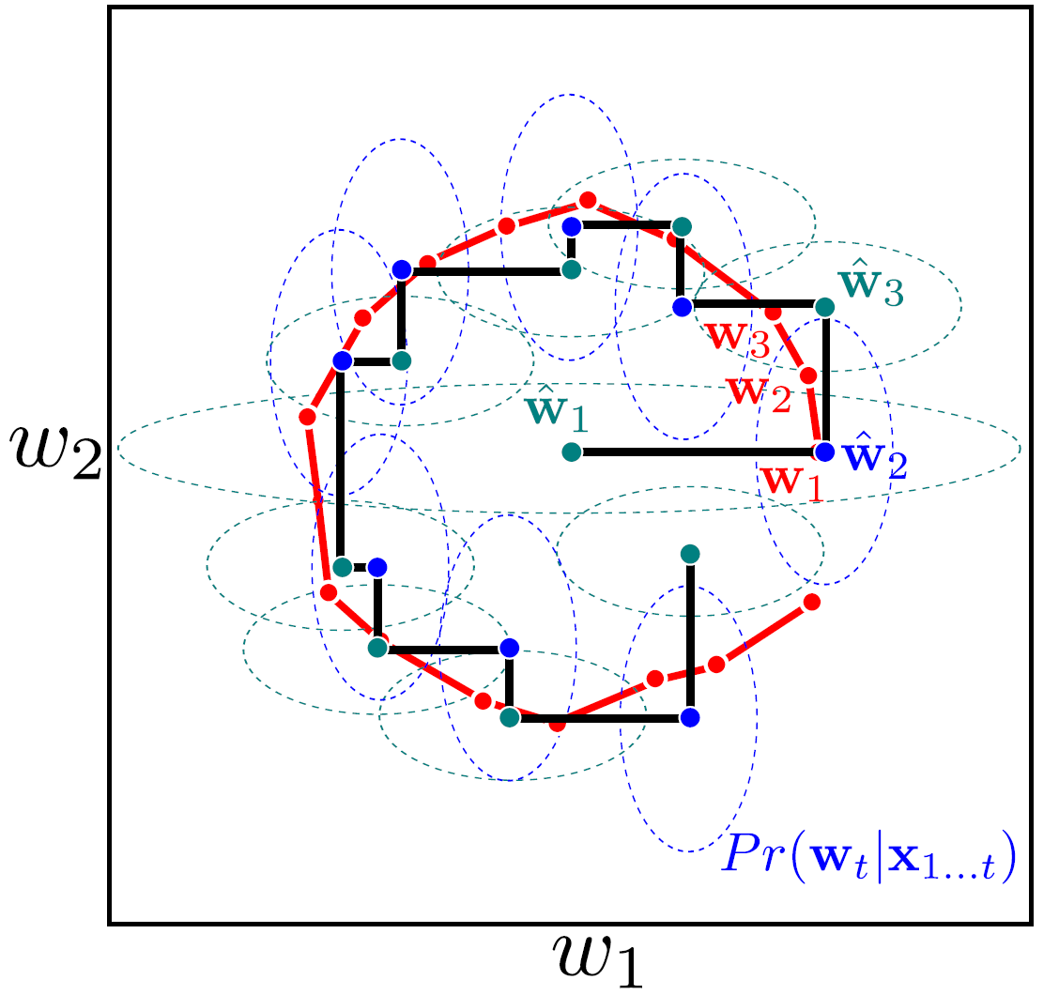
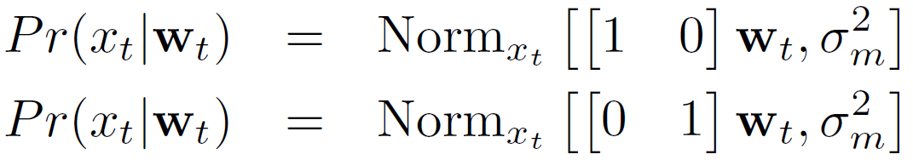
Kalman Filter Example 2
Alternates:
Computer vision: models, learning and inference. ©2011 Simon J.D. Prince
26

Slide 27
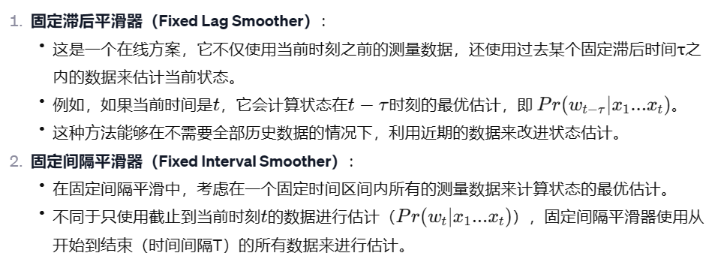
Smoothing
Estimates depend only on measurements up to the current point in time.
Sometimes want to estimate state based on future measurements as well
Fixed Lag Smoother:
This is an on-line scheme in which the optimal estimate for a state at time t -τ is calculated based on measurements up to time t, where τ is the time lag. i.e. we wish to calculate Pr(w_{t-τ} |x₁ . . .x_{t} ).
Fixed Interval Smoother:
We have a fixed time interval of measurements and want to calculate the optimal state estimate based on all of these measurements. In other words, instead of calculating Pr(w_{t} |x₁ . . .x_{t} ) we now estimate Pr(w_{t} |x₁ . . .x_{T}) where T is the total length of the interval.
Computer vision: models, learning and inference. ©2011 Simon J.D. Prince
27

Slide 28
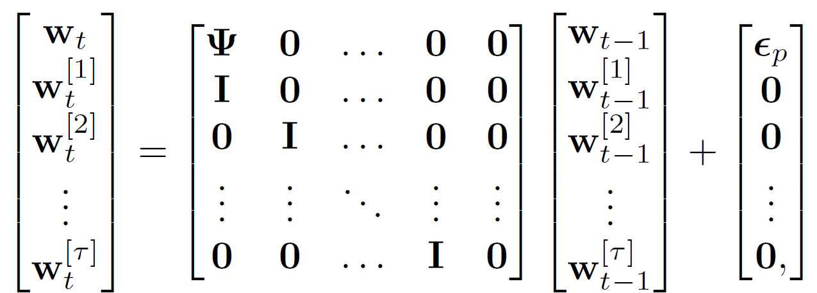
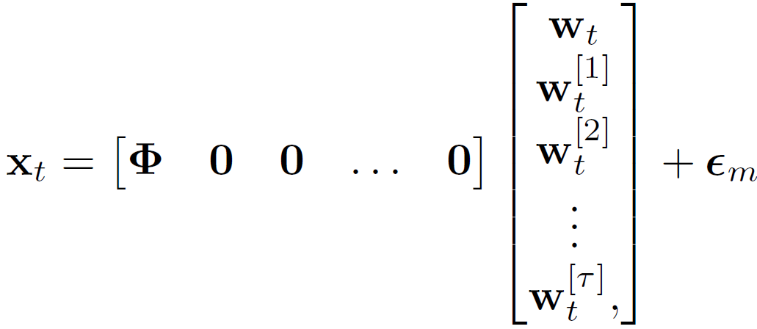
Fixed lag smoother
State evolution equation
Estimate delayed by τ
Measurement equation
Computer vision: models, learning and inference. ©2011 Simon J.D. Prince
28

Slide 29
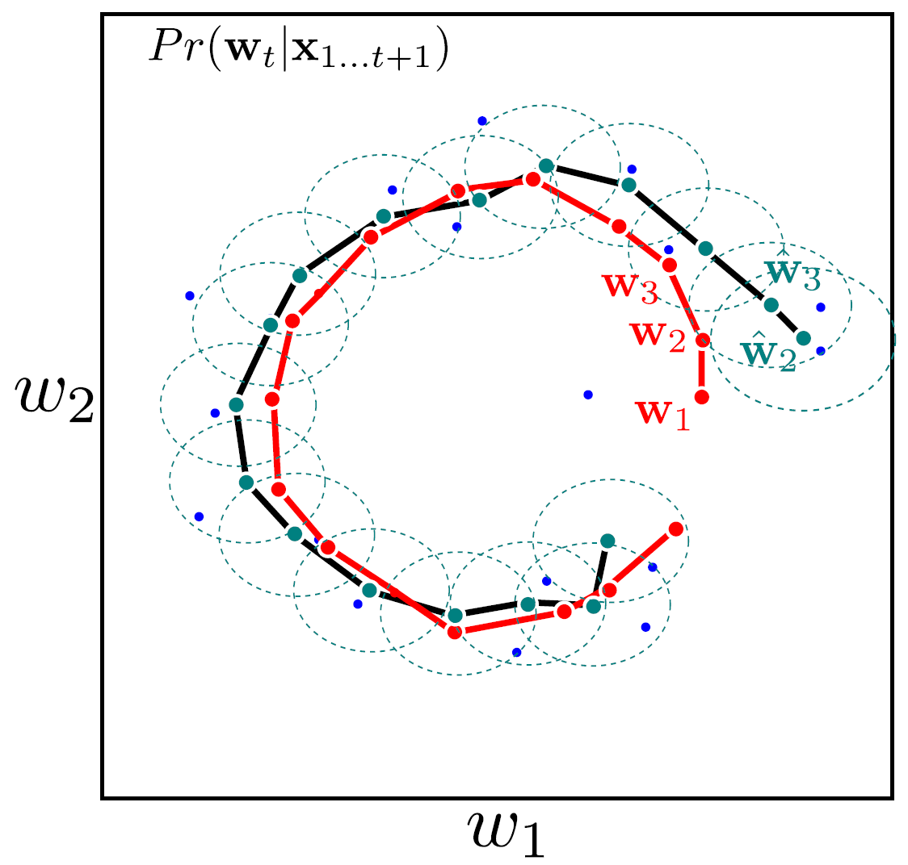
Fixed-lag Kalman Smoothing
Computer vision: models, learning and inference. ©2011 Simon J.D. Prince
29

Slide 30
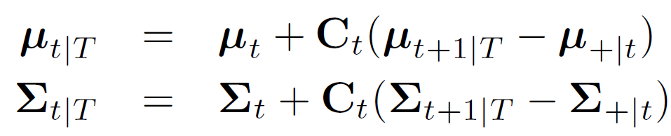
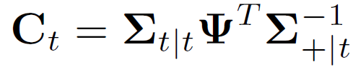
Fixed interval smoothing
Backward set of recursions
where
Equivalent to belief propagation / forward-backward algorithm
Computer vision: models, learning and inference. ©2011 Simon J.D. Prince
30

Slide 31
Temporal Models
Computer vision: models, learning and inference. ©2011 Simon J.D. Prince
31

Slide 32
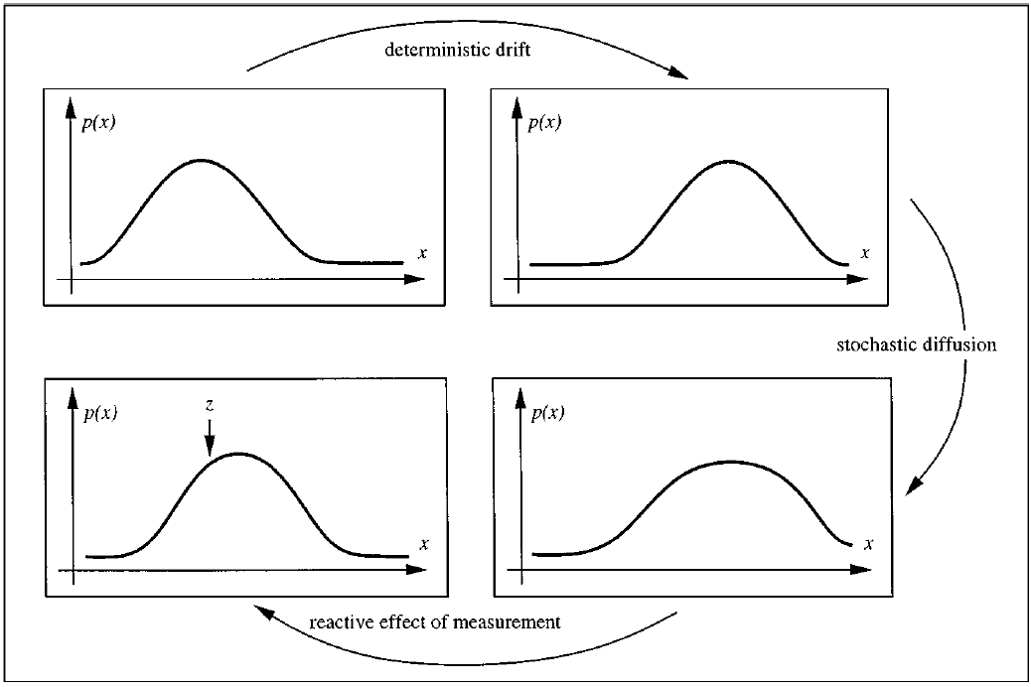
Figure from Isard & Blake ECCV 1996

Slide 33
Problems with the Kalman filter
Requires linear temporal and measurement equations
Represents result as a normal distribution: what if the posterior is genuinely multi-modal?
Computer vision: models, learning and inference. ©2011 Simon J.D. Prince
33

Slide 34

Structure
Temporal models
Kalman filter
Extended Kalman filter
Unscented Kalman filter
Particle filters
Applications
Computer vision: models, learning and inference. ©2011 Simon J.D. Prince
34

Slide 35
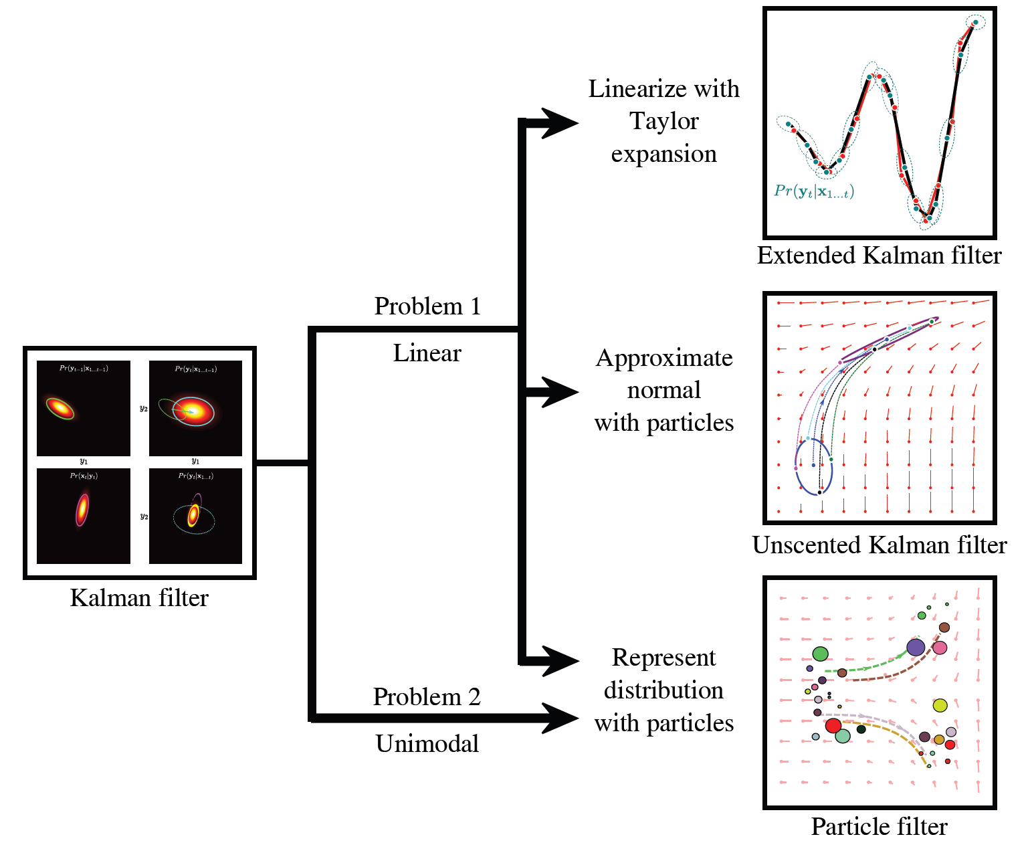
Roadmap
Computer vision: models, learning and inference. ©2011 Simon J.D. Prince
35

Slide 36
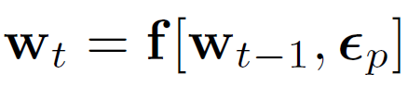
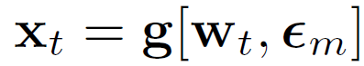
Extended Kalman Filter
Allows non-linear measurement and temporal equations
Key idea: take Taylor expansion and treat as locally linear
Computer vision: models, learning and inference. ©2011 Simon J.D. Prince
36

Slide 37
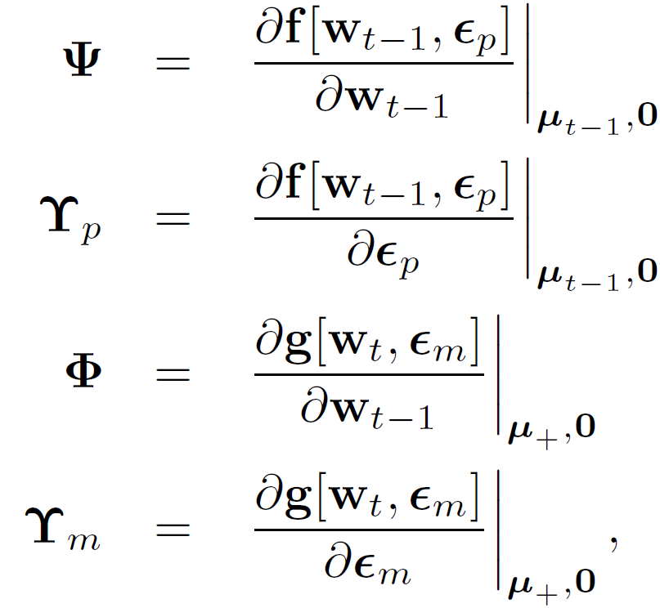
Jacobians
Based on Jacobians: matrices of derivatives
Computer vision: models, learning and inference. ©2011 Simon J.D. Prince
37

Slide 38
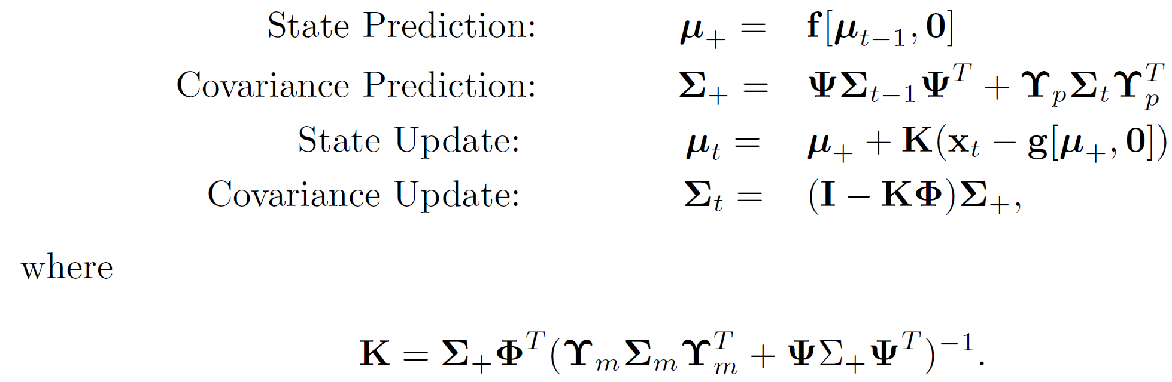
Extended Kalman Filter Equations
Computer vision: models, learning and inference. ©2011 Simon J.D. Prince
38

Slide 39
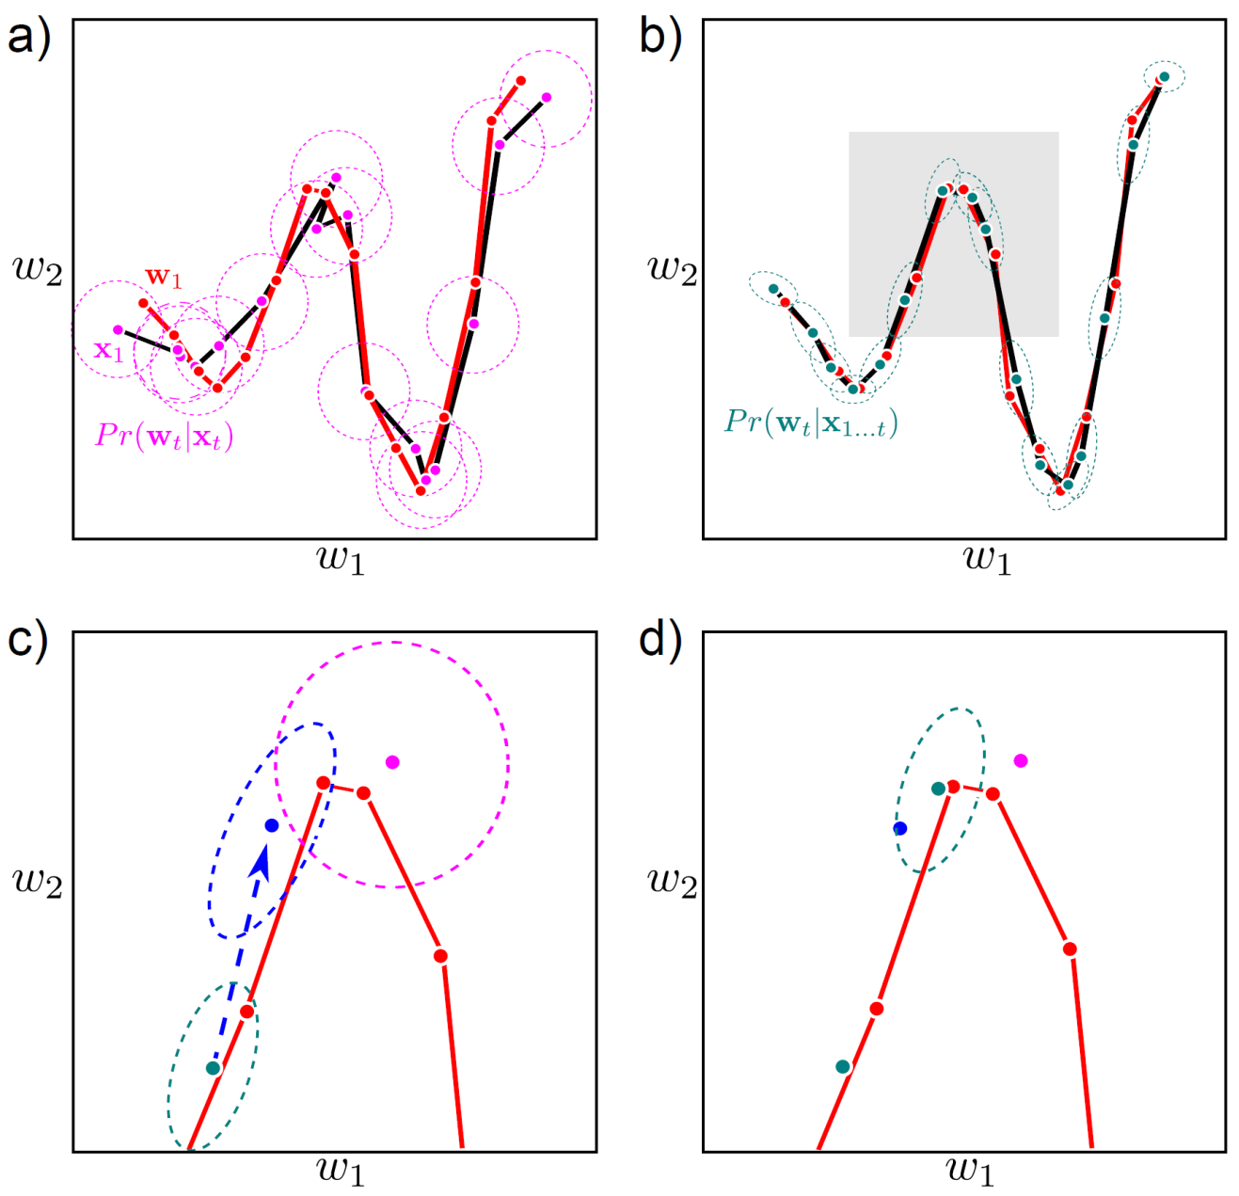
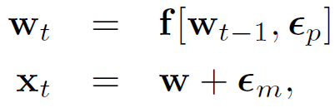
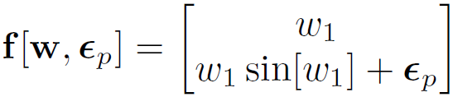
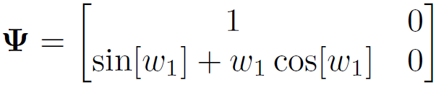
Extended Kalman Filter
Computer vision: models, learning and inference. ©2011 Simon J.D. Prince
39

Slide 40


Problems with EKF
Computer vision: models, learning and inference. ©2011 Simon J.D. Prince
40

Slide 41
Structure
Temporal models
Kalman filter
Extended Kalman filter
Unscented Kalman filter
Particle filters
Applications
Computer vision: models, learning and inference. ©2011 Simon J.D. Prince
41

Slide 42

Unscented Kalman Filter
Key ideas:
Approximate distribution as a sum of weighted particles with correct mean and covariance
Pass particles through non-linear function of the form
Compute mean and covariance of transformed variables
Computer vision: models, learning and inference. ©2011 Simon J.D. Prince
42

Slide 43


Unscented Kalman Filter
Approximate with particles:
Choose so that
Computer vision: models, learning and inference. ©2011 Simon J.D. Prince
43

Slide 44


One possible scheme
With:
Computer vision: models, learning and inference. ©2011 Simon J.D. Prince
44

Slide 45

Reconstitution
Computer vision: models, learning and inference. ©2011 Simon J.D. Prince
45

Slide 46

Unscented Kalman Filter
Computer vision: models, learning and inference. ©2011 Simon J.D. Prince
46

Slide 47


Measurement incorporation
Measurement incorporation works in a similar way:
Approximate predicted distribution by set of particles
Particles chosen so that mean and covariance the same
Computer vision: models, learning and inference. ©2011 Simon J.D. Prince
47

Slide 48



Measurement incorporation
Pass particles through measurement equation and recompute mean and variance:
Measurement update equations:
Kalman gain now computed from particles:
Computer vision: models, learning and inference. ©2011 Simon J.D. Prince
48

Slide 49

Problems with UKF
Computer vision: models, learning and inference. ©2011 Simon J.D. Prince
49

Slide 50
Structure
Temporal models
Kalman filter
Extended Kalman filter
Unscented Kalman filter
Particle filters
Applications
Computer vision: models, learning and inference. ©2011 Simon J.D. Prince
50

Slide 51

Figure from Isard & Blake ECCV 1996

Slide 52

Particle filters
Key idea:
Represent probability distribution as a set of weighted particles
Advantages and disadvantages:
+ Can represent non-Gaussian multimodal densities
+ No need for data association
- Expensive
Computer vision: models, learning and inference. ©2011 Simon J.D. Prince
52

Slide 53


Condensation Algorithm
Stage 1: Resample from weighted particles according to their weight to get unweighted particles
这里权重大的重复采样，权重小的扔掉
Computer vision: models, learning and inference. ©2011 Simon J.D. Prince
53

Slide 54

Condensation Algorithm
Stage 2: Pass unweighted samples through temporal model and add noise
Computer vision: models, learning and inference. ©2011 Simon J.D. Prince
54

Slide 55

Condensation Algorithm
Stage 3: Weight samples by measurement density
Computer vision: models, learning and inference. ©2011 Simon J.D. Prince
55

Slide 56

Data Association
Computer vision: models, learning and inference. ©2011 Simon J.D. Prince
56

Slide 57
Structure
Temporal models
Kalman filter
Extended Kalman filter
Unscented Kalman filter
Particle filters
Applications
Computer vision: models, learning and inference. ©2011 Simon J.D. Prince
57

Slide 58


Tracking pedestrians
Computer vision: models, learning and inference. ©2011 Simon J.D. Prince
58

Slide 59

Tracking contour in clutter
Computer vision: models, learning and inference. ©2011 Simon J.D. Prince
59

Slide 60


Simultaneous localization and mapping
Computer vision: models, learning and inference. ©2011 Simon J.D. Prince
60

Slide 61


